Slide 1
Time-reversal symmetric topological superconductivity in Machida-Shibata lattices
Thore Posske, Universität Hamburg, Germany ICSM 2025, Fethiye, Turkiye
arXiv:2504.08674 (2025) www.posske.de

Slide 2
Summary
Nonmagnetic in-gap state on superconductors: Machida-Shibata state
Hybridizing lattices of Machida-Shibata states accommodates topological superconductor, class DIII
Small spin orbit coupling creates topologically nontrivial phase
Kramers degenerate Majorana bound states (1D) and dispersive chiral Majorana edge channels (2D)
Exact compensation of singlet and triplet superconductivity in parts of the Brillouin zone
Notes:
- Nonmagnetic ⬄ time reversal invariant
-

Slide 3
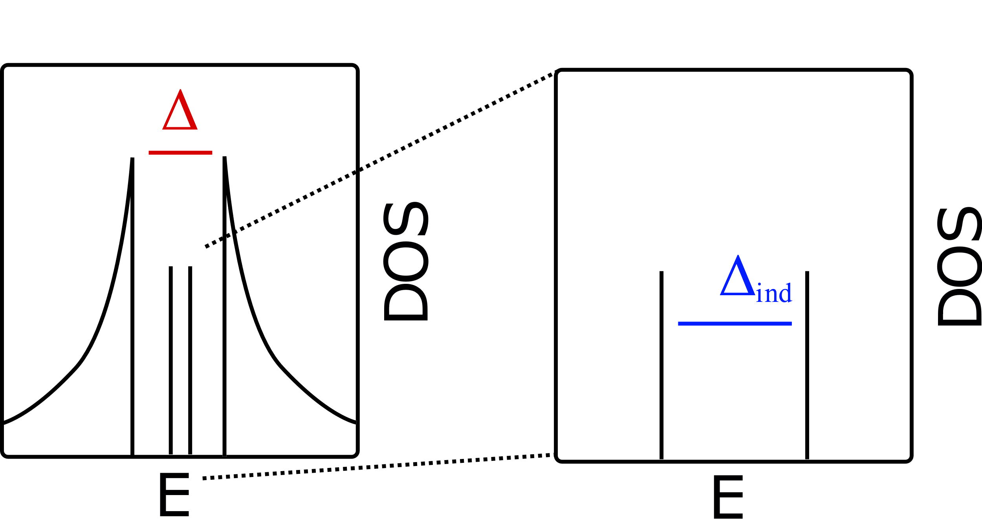
Motivation
Low-energy (in-gap) electronic states in superconductors

Slide 4
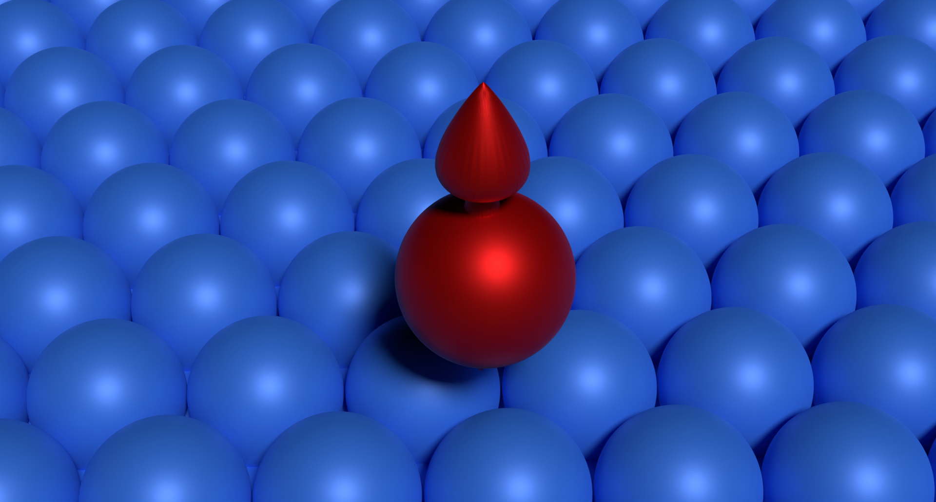
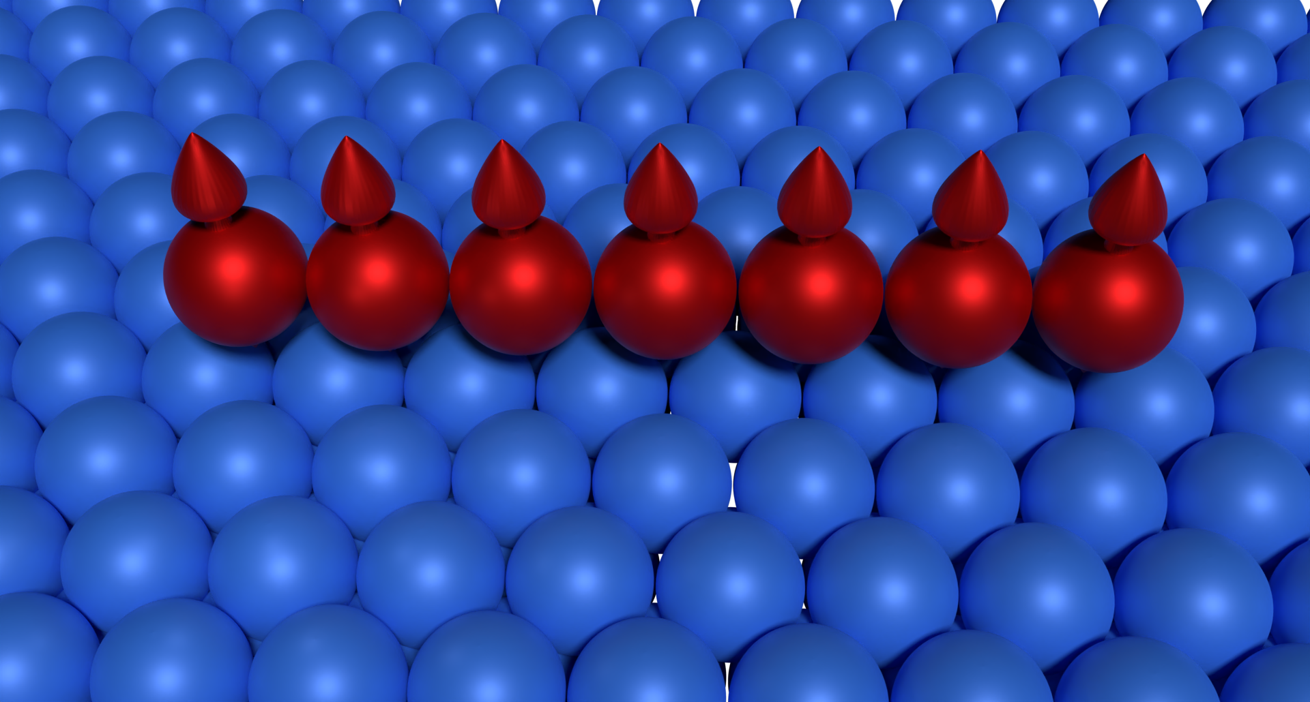
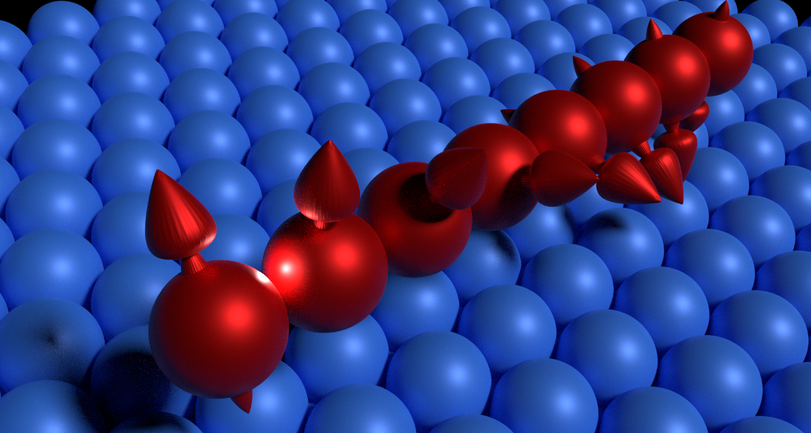
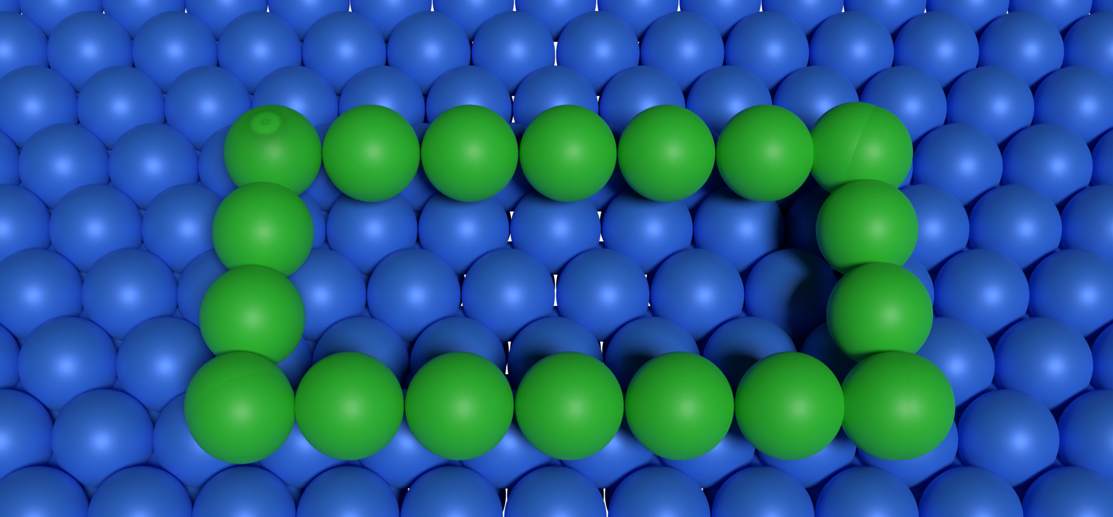
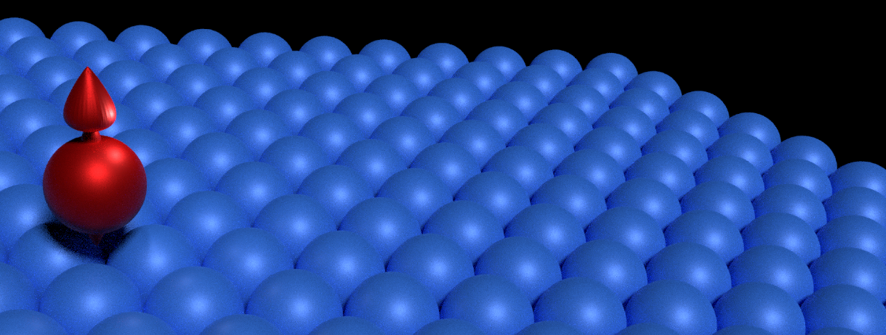
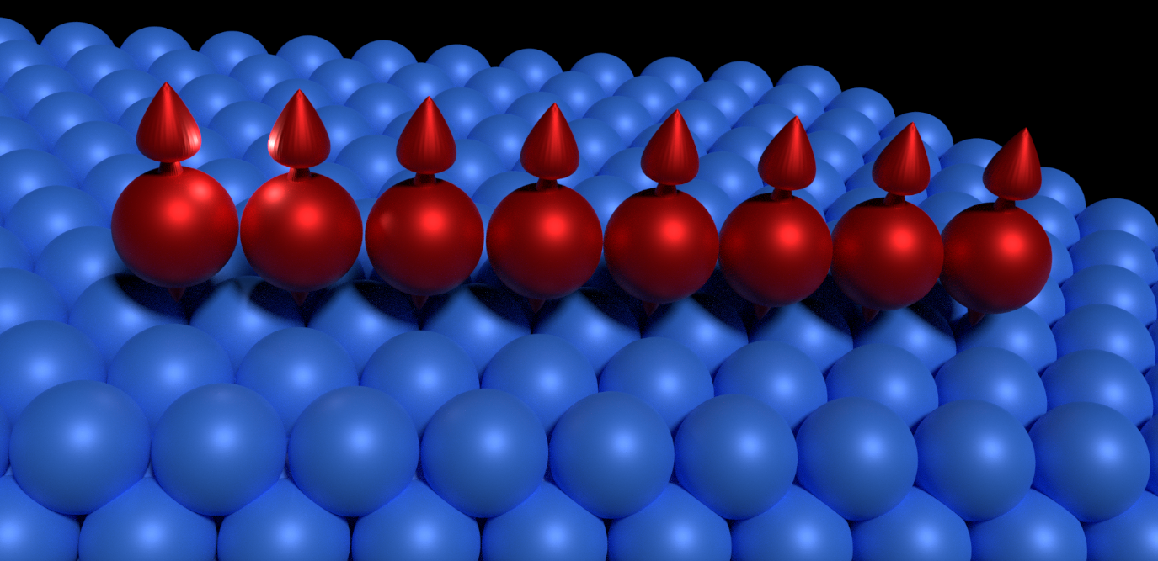
Lego kit of in-gap states for synthesizing 2D quantum matter
Shiba chains Precursors of Majorana modes
Helical magnetism Majorana modes
Yu-Shiba-Rusinov states
Nonmagnetic adatoms
Machida-Shibata states
Notes:
Nonmagnetic adatoms and Andreev states

Slide 5
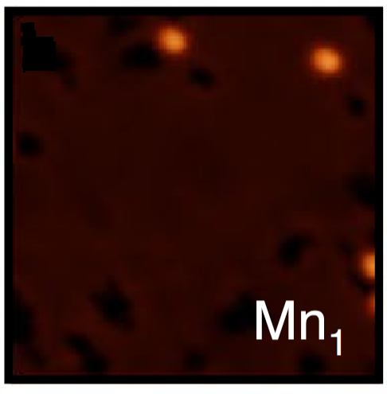
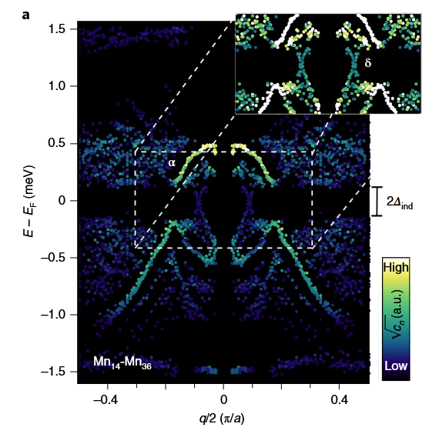
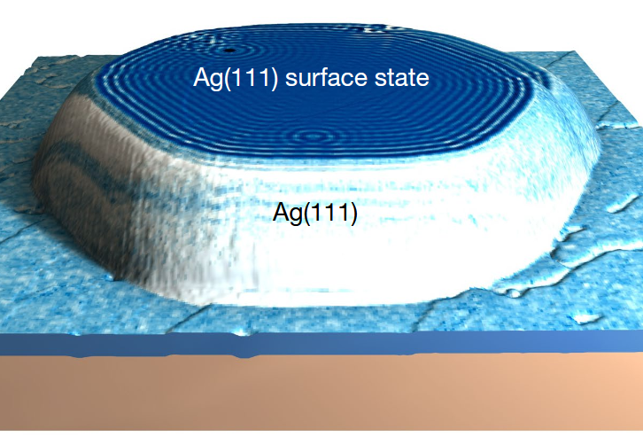
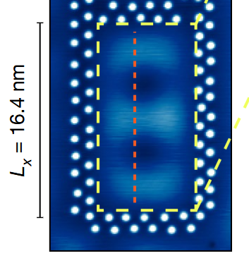
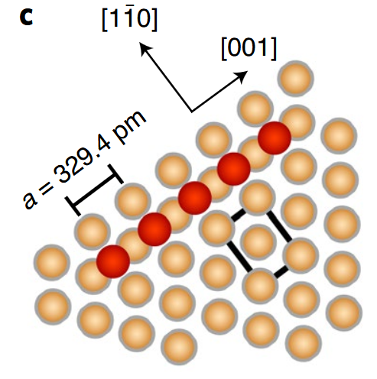
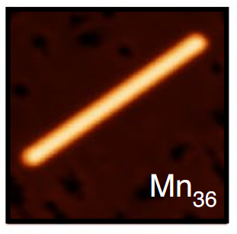
Motivation
Magnetic adatoms Yu-Shiba-Rusinov states hybridization ⇒ top. YSR bands
Nonmagnetic adatoms Machida-Shibata states hybridization ⇒ ?
Schneider et al., Nature Physics 17, 943 (2021)
Schneider et al., Nature 621, 60 (2023)
Notes:
Khajetoorians, Franke as well!
Mn [001] chains on Nb

Slide 6
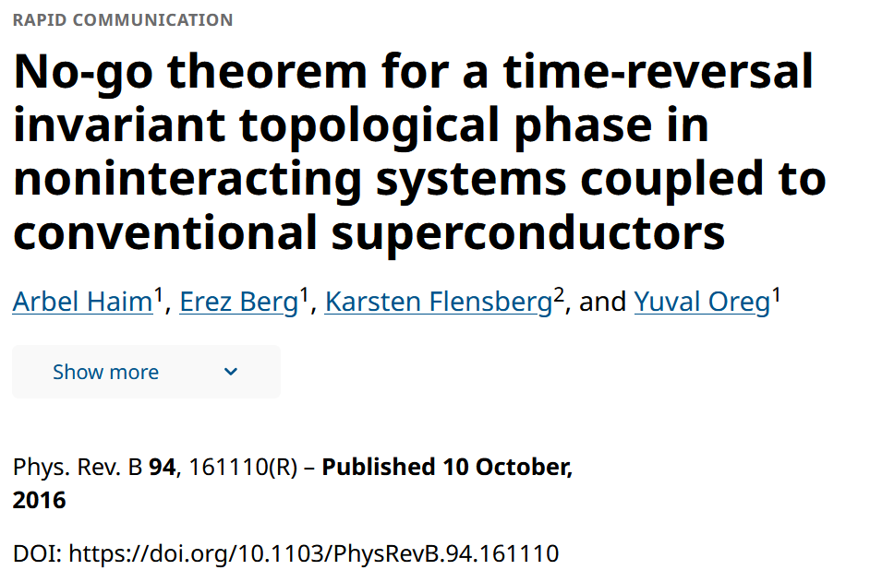
Motivation

Slide 7
People
Ioannis Ioannidis U Hamburg
Ching-Kai Chiu RIKEN
Thore Posske U Hamburg

Slide 8
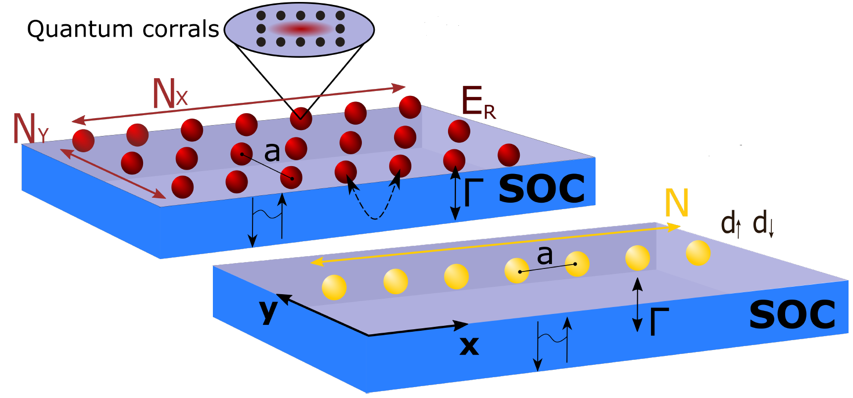
Machida-Shibata lattices

Slide 9
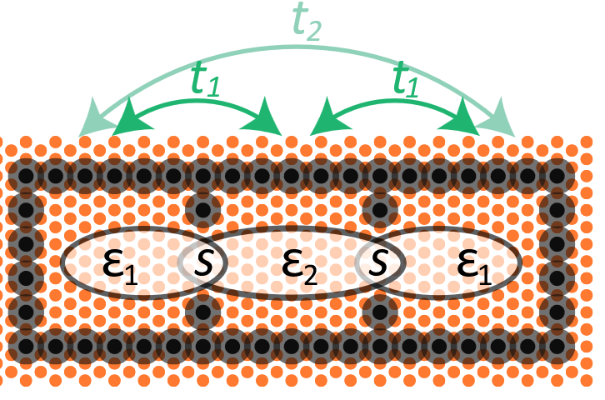
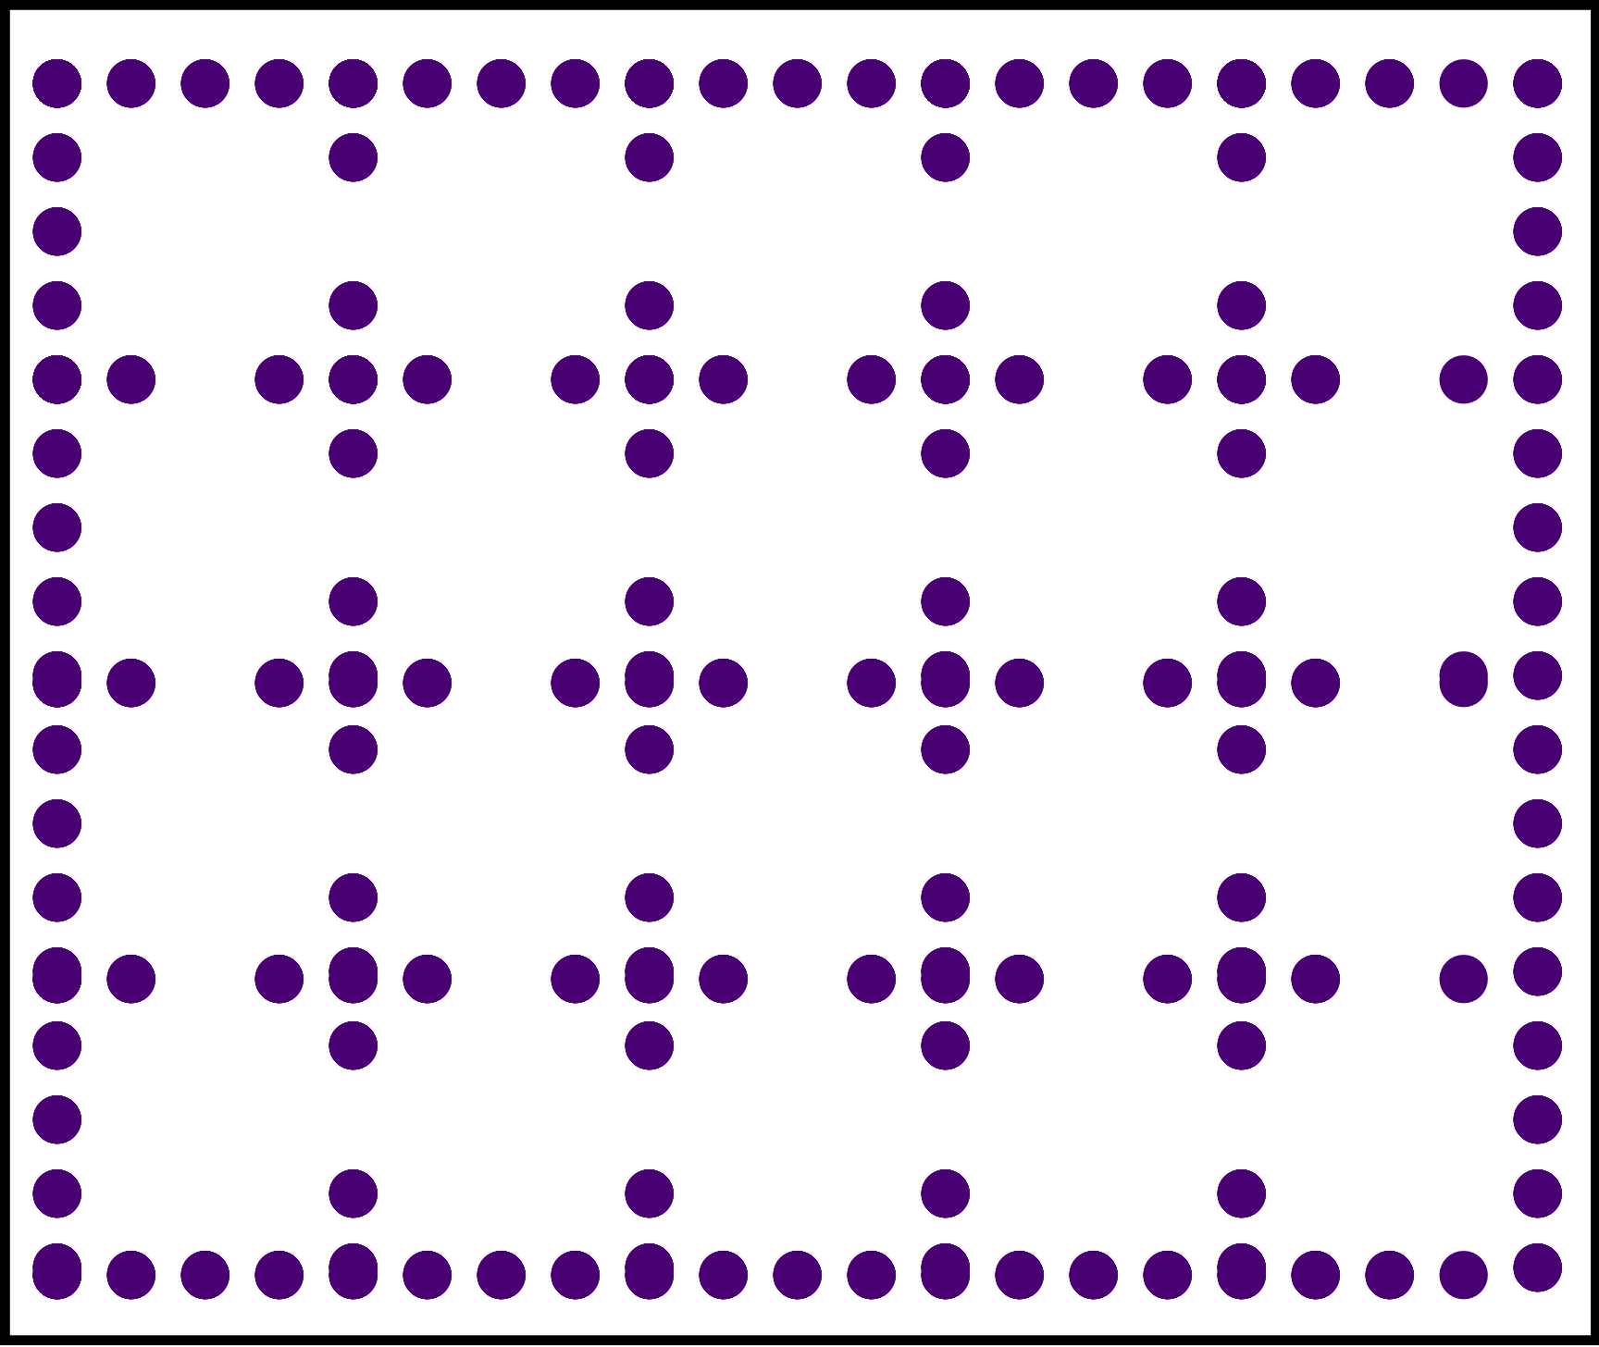
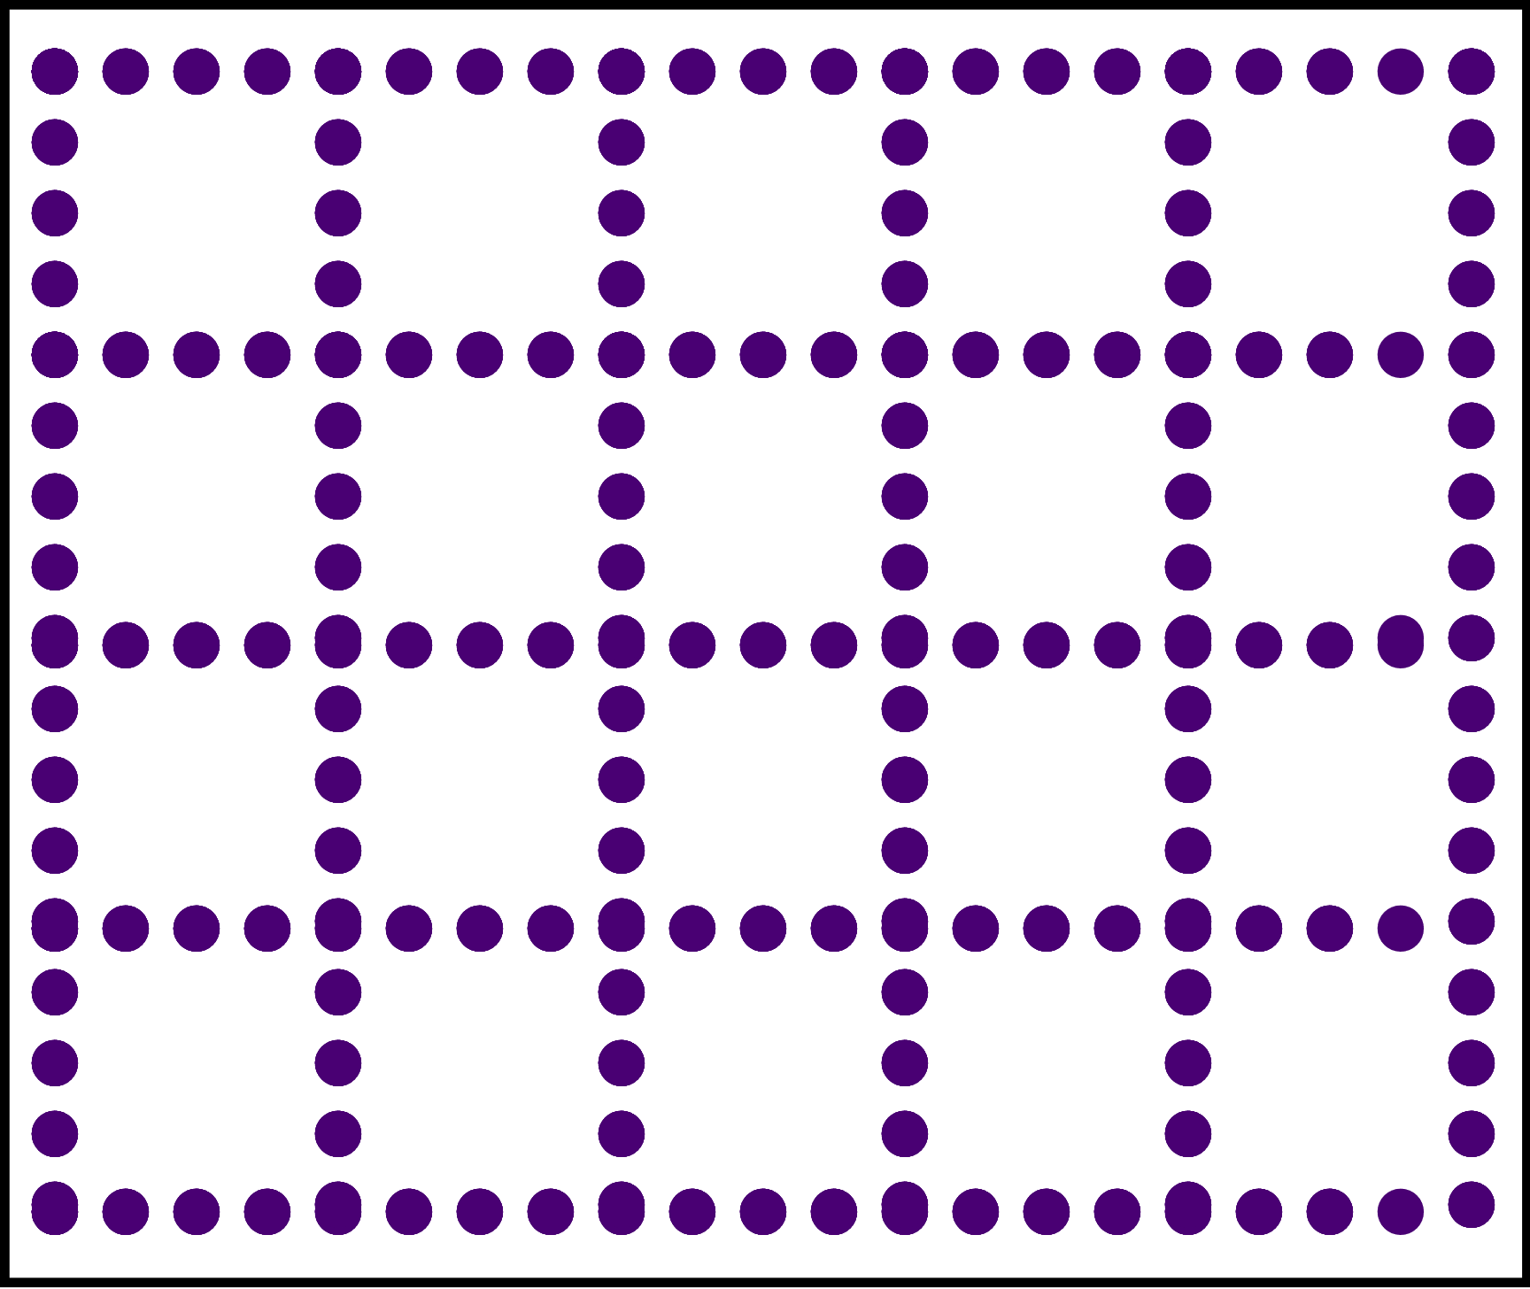
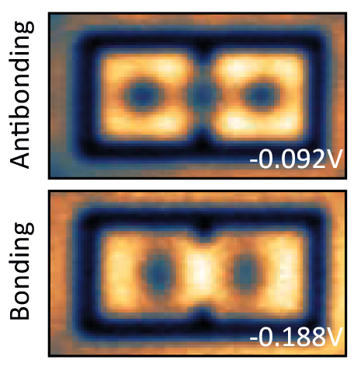
Machida Shibata lattices, proposal
Jolie … Khajetoorians et al. ACS Nano, 16, 4876 (2022)
Freeney et al., SciPost Phys. 9, 085 (2020)
Notes:
Khajetoorians: Fe on BiCu₂
freeney: CO molecules on Cu(111)

Slide 10
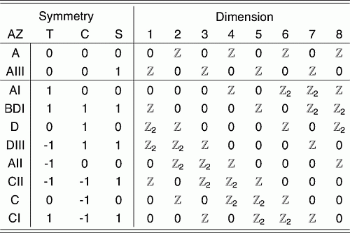
Symmetry class
Time-reversal symmetry T (no magnetic field)
Particle-hole symmetry C (superconductor)
Chiral symmetry ($S=T⋅C$)

Slide 11
Hamiltonian

Slide 12
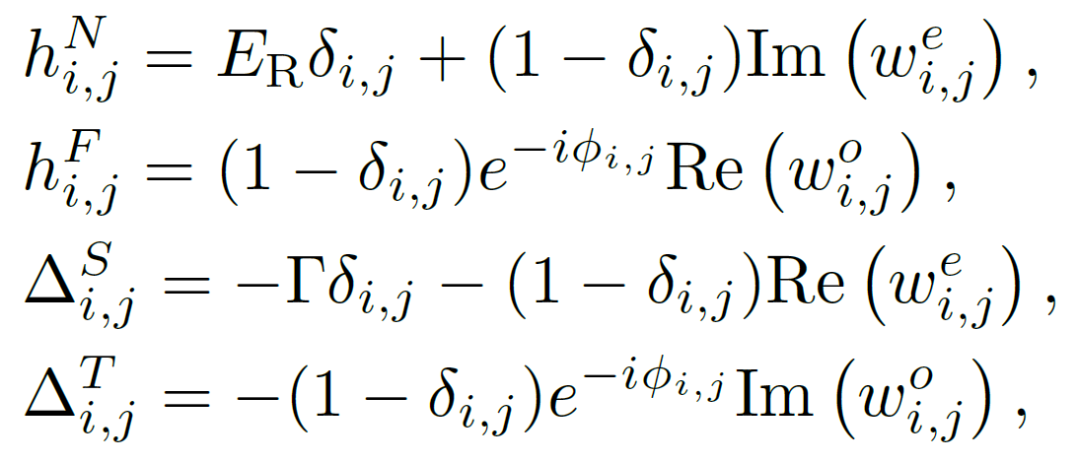
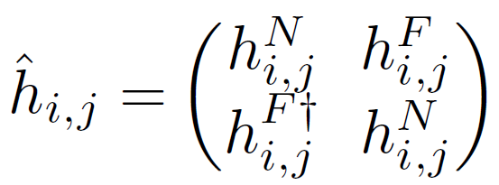
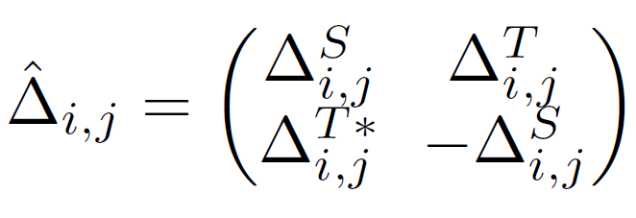
Effective Hamiltonian

Slide 13
Effective parameters
Notes:
Add details about Struve and Bessel function

Slide 14
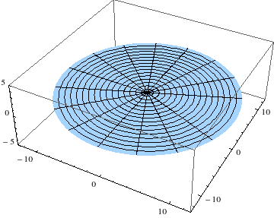
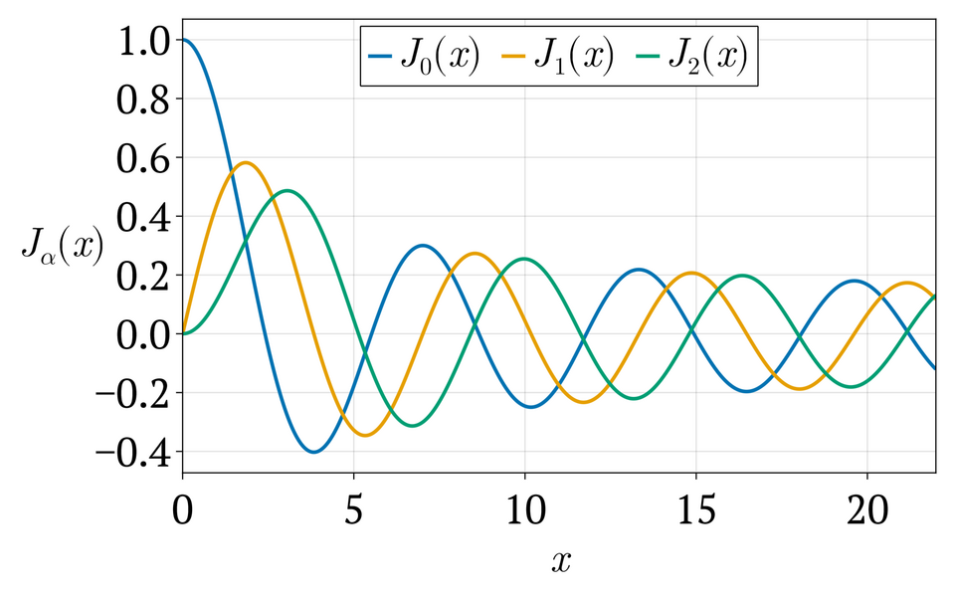
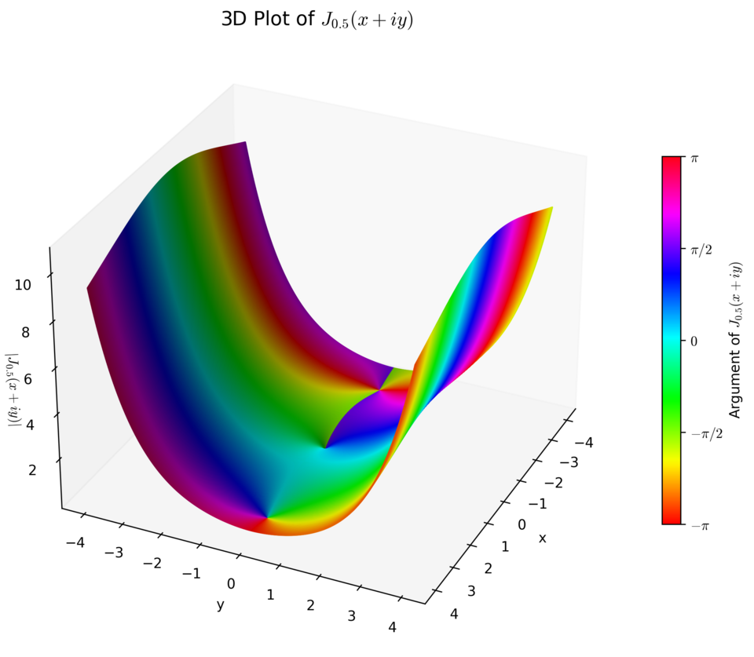
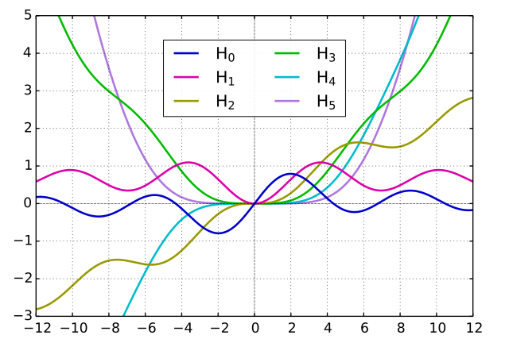
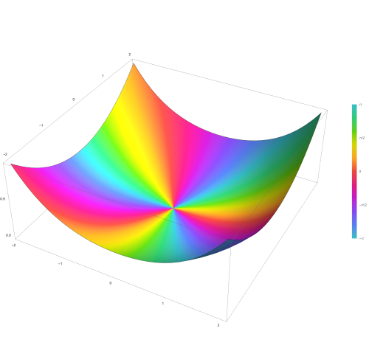
Bessel and Struwe functions
Bessels differential equation
$$\left(x^{2}∂_{x}^{2}+x∂_{x}+\left(x^{2}−α^{2}\right)\right)y \sim x^α$$
Bessel function of first kind (hom. sol.)
$$J_{α}\left(x\right)=\frac{1}{π}Re\left(\int_{0}^{π}{e^{i\left(ατ−x\sin{(τ}\right)}}dτ\right)$$
Struve function (inhomogeneous solution)
$$H_{α }\left(x\right) \sim \frac{1}{π}\int_{0}^{π/2}{\sin\left(x sin⁡(τ)\right)\cos{{\left(τ\right)}^{2α}}}dτ$$
https://wikimedia.org/api/rest_v1/media/math/render/svg/c9e81a0e25186697d3ce13726811dada840628bb
Notes:
Struve function: Solution of the inhomogeneous Bessel‘s differential equation (inhomogeneity basically x^{\alpha +1)

Slide 15
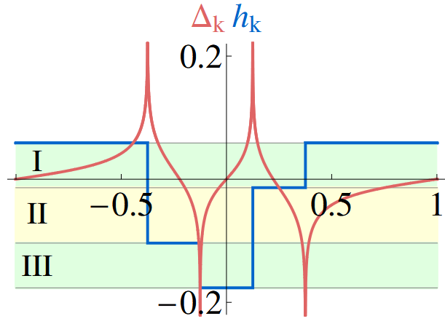
Effective parameters in momentum space example: YSR bands
Pientka et al., PRB 88, 155420 (2013)

Slide 16
Solution – selected details
Green‘s function equations of motion
Gap closure condition in 1D
https://arxiv.org/abs/2504.08674

Slide 17
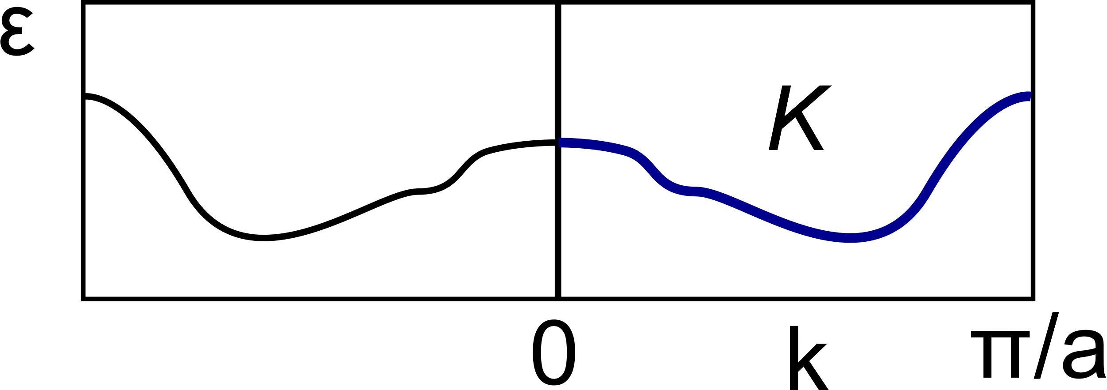
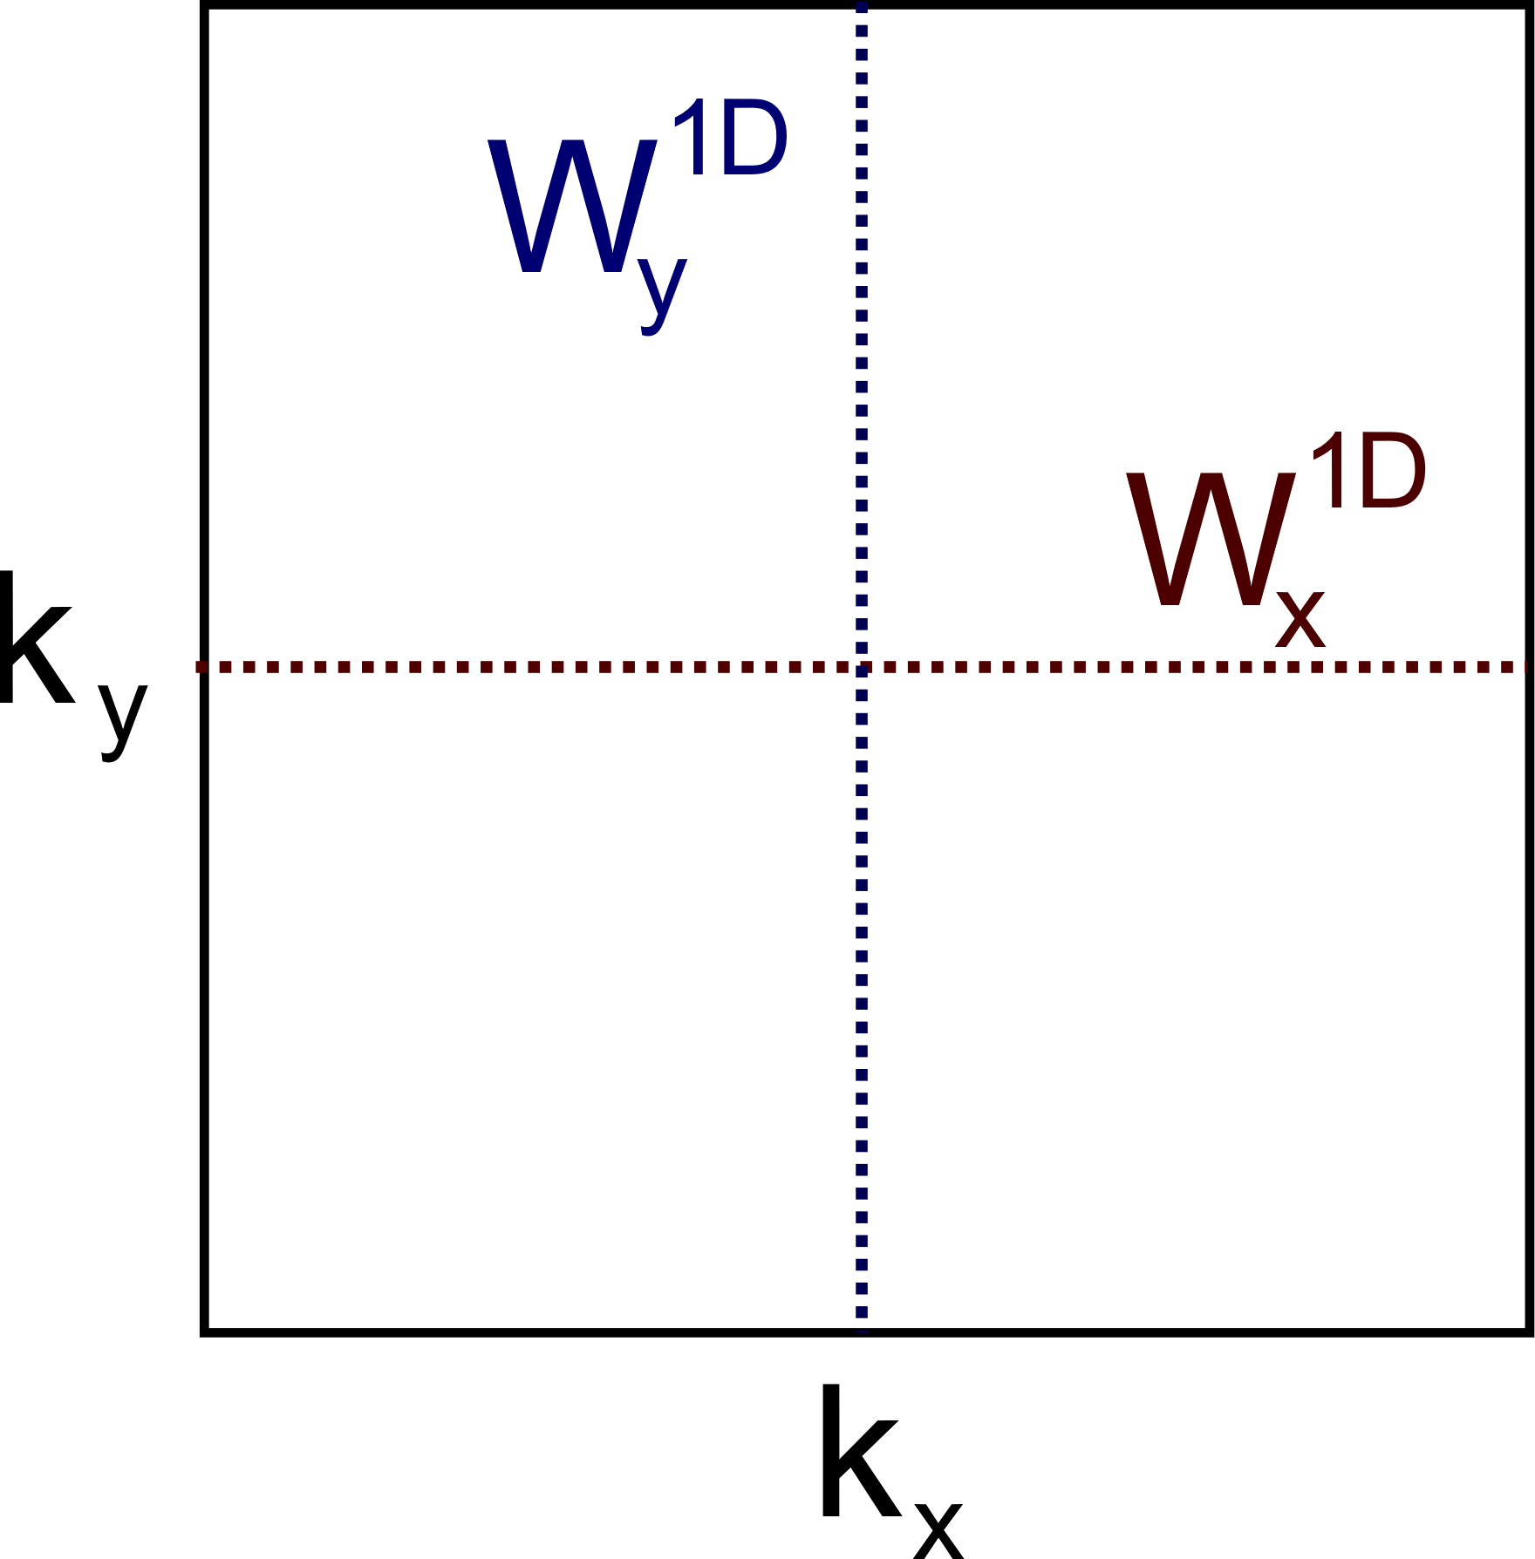
Topological analysis
1D
Class DIII topological invariant
With Kato propagator $K$ from $k=0$ to $k=π$ $θ_{k}$ represents time reversal symmetry.
2D
$$W^{2D}=W_{k_{y}→0}^{1D}×W_{k_{x}→0}^{1D}$$
Ardonne, Budich Phys. Rev. B 88, 134523 (2013)
Haim, Berg, Flensberg, Oreg, Phys. Rev. B 94, 161110(R) (2016)

Slide 18
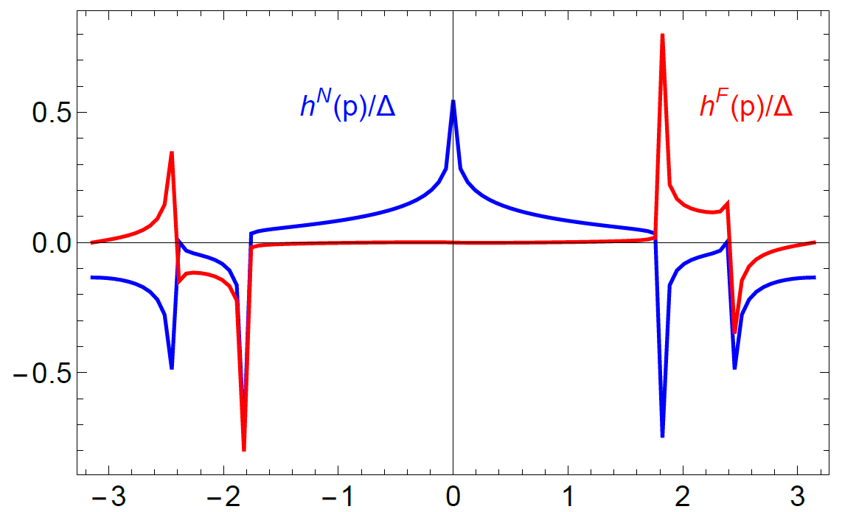
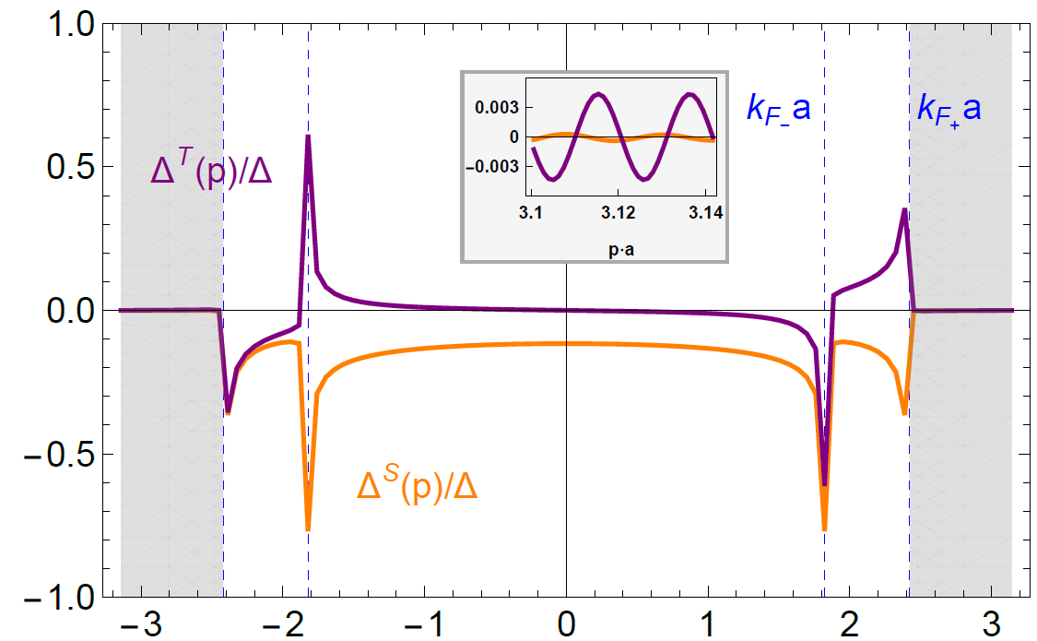
Effective parameters in momentum space
Problem: For topological superconductivity triplet > singlet needed

Slide 19
Solution 1 – Nearest neighbor cutoff
Only consider coupling between closes corrals
Further couplings negligibly small for geometric reasons

Slide 20
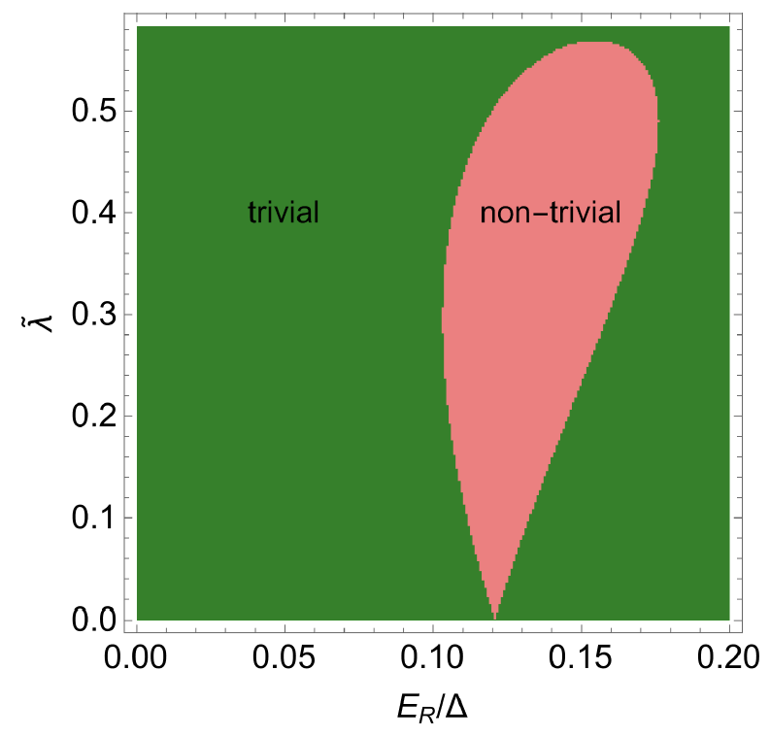
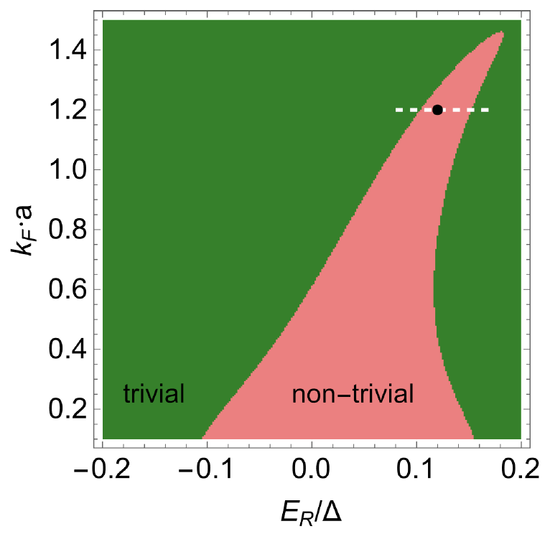
1D topological phase diagram

Slide 21
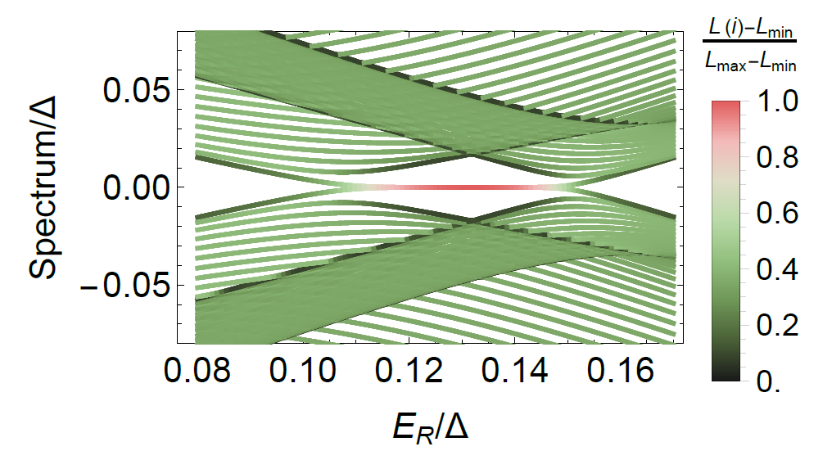
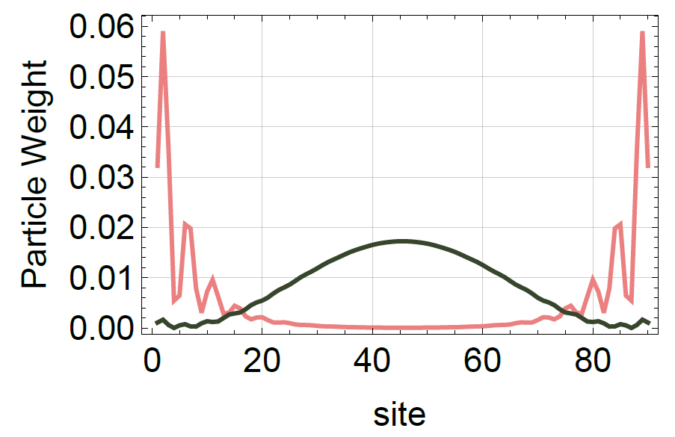
Majorana bound states
2x Kramers degenerate Majorana boundary modes
Ardonne, Budich Phys. Rev. B 88, 134523 (2013)
C.-H. Hsu, P. Stano, J. Klinovaja, and D. Loss, Phys. Rev. Lett. 121, 196801 (2018)
Notes:
Each side!

Slide 22
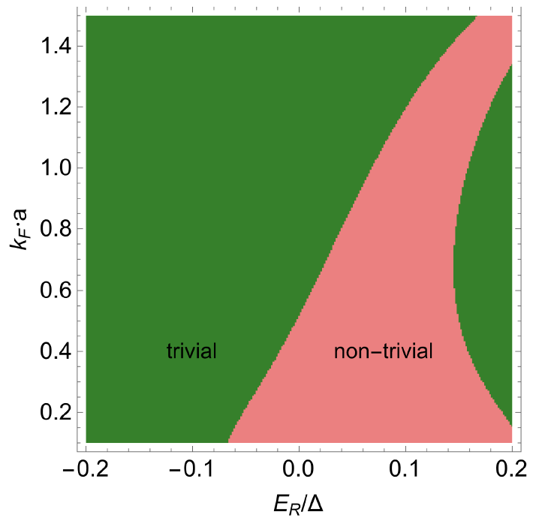
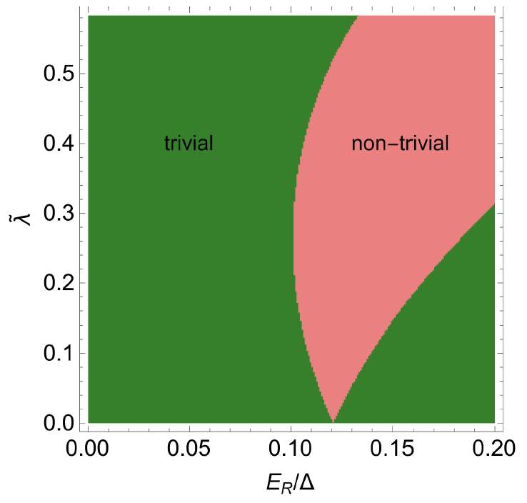
2D topological phase diagram
distance of impurities $a$ and Fermi wave vector $k_{F}$
effective spin-orbit coupling

Slide 23
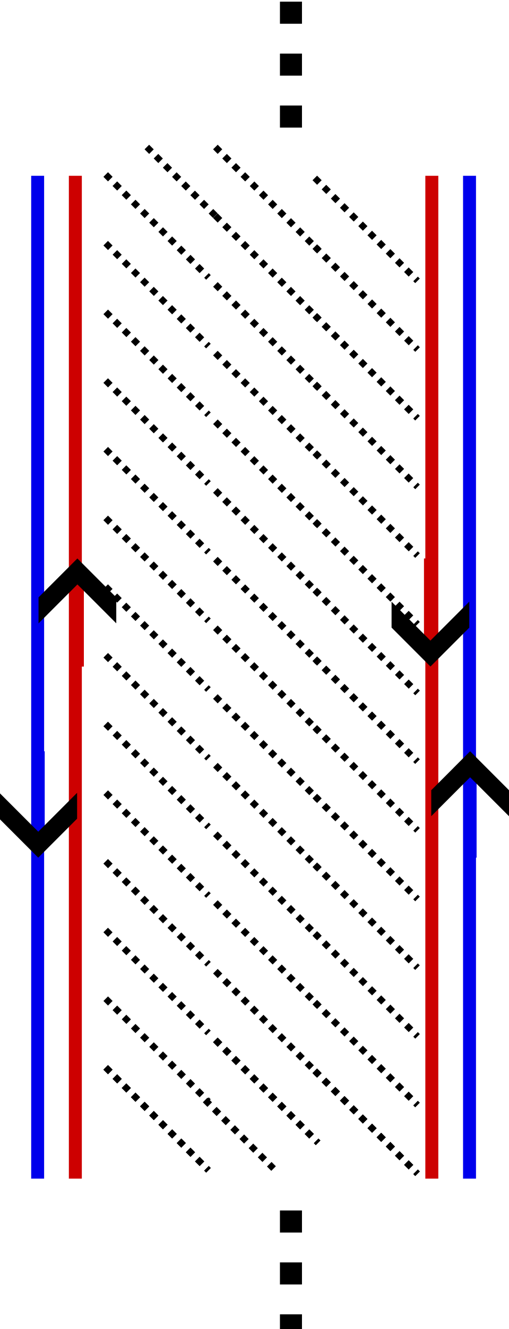
Chiral Majorana edge channels

Slide 24
Solution 2 – suppress singlet superconductivity
Mean field decoupling and minimization of free energy

Slide 25
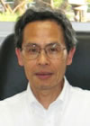
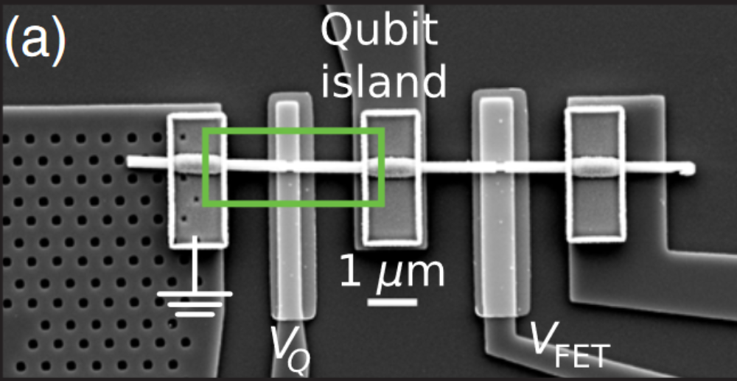
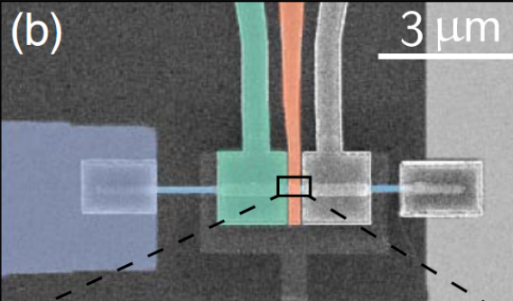
Applications of Machida-Shibata states
Kazushige MACHIDA
Professor, Department of Physics, Okayama University
Topics of Research：
Theoretical studies on topological excitations in spin triplet superfluids of ³He and UPt₃
■ Laboratory Website ■ Description of Research [1008KB]
RESEARCH
I am interested in the interplay between strongly correlated systems, such as heavy Fermion superconductors and topological nature of materials. Together with several experimental groups, including the members in this research project, I mainly work on the theoretical aspects of this interplay. My current focuses are on one of typical heavy Fermion superconductors, UPt₃ and also on superfluid ³He A and B-phases. They share a similar topological character because those superfluids are believed to be described by triplet pairing function in common.
As for UPt₃, I am now investigating the topological properties of vortices and surfaces which turn out to accommodate Majorana quasi-particles in the vortex core and the interface respectively. Thus it is urgent to consider how to detect those Majorana particles experimentally. It is my intension to investigate possible experimental methods in collaboration with the experimental groups in this project.
As for ³He superfluids I am planning to closely work with the experimentalists in this area of this project and help them to perform the best experiments in connection with their experimental missions. In particular, I try to design meaningful experiments using the rotating cryostats in ISSP, Univ. Tokyo, which are the world top facility.
EDUCATION
1968
B.Sc. in Physics, Tokyo University of Education
1973
Ph.D. Tokyo University of Education (Advisor: F. Takano)
PROFESSIONAL EXPERIENCE
1974-1990
Assistant, Department of Physics, Kyoto University
1990-2010
Associate and full Professor, Department of Physics, Okayama University
2010-Present
Professor Emeritus, Okayama University
SELECTION OF PUBLICATIONS
"Twofold Spontaneous Symmetry Breaking in the Heavy-Fermion Superconductor UPt₃", Y. Machida, A. Itoh, Y. So, K. Izawa, Y. Haga, E. Yamamoto, N. Kimura, Y. Onuki, Y. Tsutsumi, and K. Machida Phys. Rev. Lett. 108, 157002-1-5 (2012).
"Stable Skyrmions in SU(2) Gauged Bose-Einstein Condensates", T. Kawakami, T. Mizushima, M. Nitta, and K. Machida Phys. Rev. Lett. 109, 015301-1-5 (2012).
"Symmetry Protected Topological Order and Spin Susceptibility in Superfluid ³He-B", T. Mizushima, M. Sato, and K. Machida Phys. Rev. Lett. 109, 165301-1-5 (2012).
Additional prospects: Transmon qubit + quantum dot
.. thank you for finding utility of Machida-Shibata lattice as a possible time-reversal symmetric topological superconductivity. I really hope that your proposal is realized near future.
Sincerely,
Kazu Machida
Bargerbos
An important application is the transmon qubit, a variant of the Cooper pair box qubit [3] where the Josephson energy EJ of the junction exceeds the charging energy, EC ¼ e2=2C, of the shunting capacitor with capacitance C. Designing qubits with ratio EJ =EC considerably greater than unity exponentially sup- presses its charge character, correspondingly reducing its sensitivity to voltage noise and dramatically extending coherence [4,5]. The trade-off with increasing E J =EC is reduced anharmonicity, which determines the minimal oper- ation time due to leakage out of computational states [6].
Kringhøj et al. PRL 124, 246803 (2020)
Kazushige Machida
“I thought for long time that transition metal non-magnetic impurities
produce the in-gap state, but the location of it is so near the
superconducting gap edge, thus it is impossible to prove
its existence. But by your ingenious method you have finally checked it
to be true experimentally.
[…]
I hope that this time reversal preserving Machida-Shibata state turns out to be of some use for the future as application or fundamental physics.”
Bargerbos et al. PRL 124, 246802 (2020)
In a similar fashion, charge quantization on a JJ-coupled superconducting island is expected to be suppressed for highly transmissive modes and vanish for unity trans- mission of a mode [24], irrespective of the ratio EJ =EC, though to our knowledge this has not been previously investigated experimentally
Suppressed voltage noise + strong anharmonicity
Notes:
Charging energy E_C
Anharmonicity -> leakage to higher energy modes
Two-gate version of the MSS
Kringhoj: Marcus
Bargerbos: Kouwenhoven

Slide 26
Summary
Machida-Shibata lattices
Topological superconductor, class DIII, Kramers degenerate Majorana modes
Compensating singlet and triplet superconductivity in momentum space

Slide 27
Gap closure and opening

Slide 28
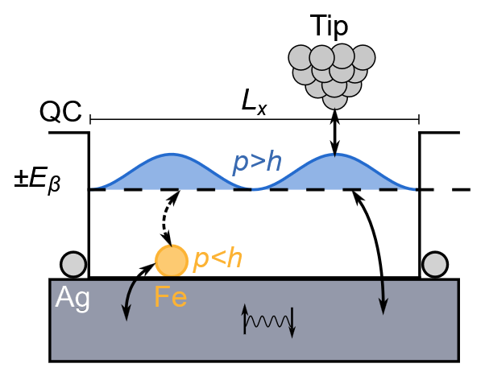
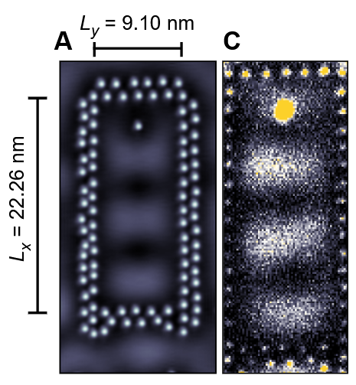
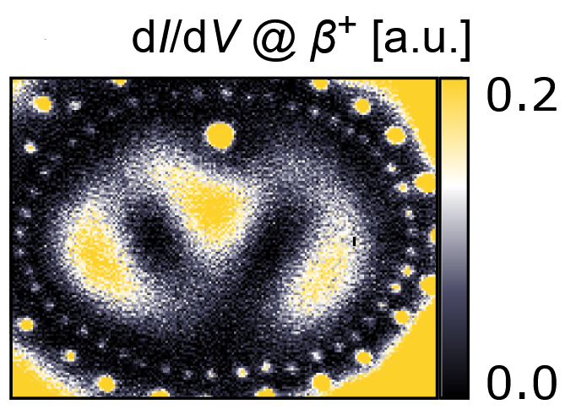
Outlook
arXiv:2410.16054
YSR states
Machida-Shibata states
Hybridizing Machida-Shibata states and Yu-Shiba-Rusinov states
Splitting Kramers degeneracy, further topological phases upon hybridization
That, Xu, Ioannidis, Schneider, Posske, Wiesendanger, Morr, Wiebe, arXiv:2410.16054

Slide 29
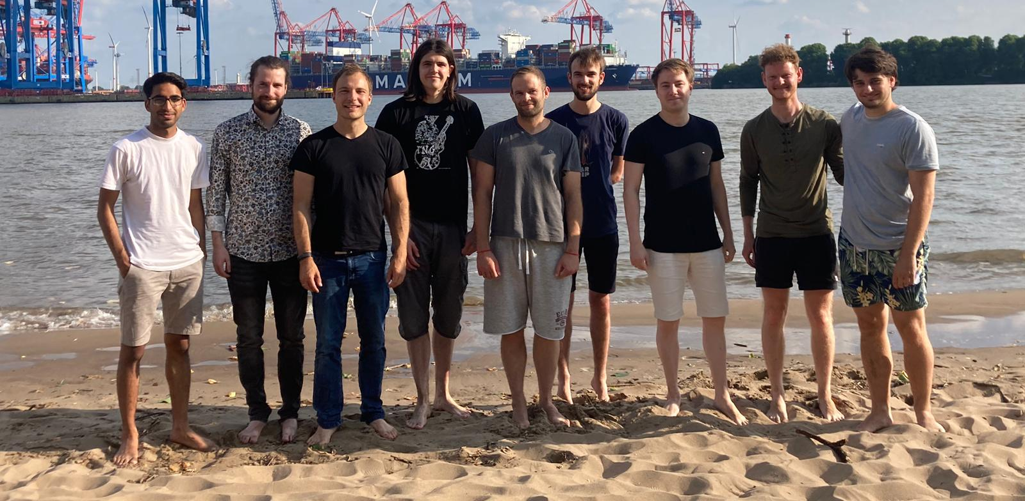
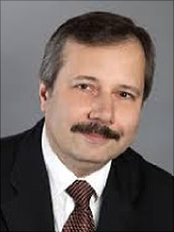
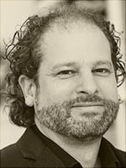
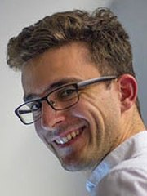
Acknowledgements
Ioannis Ioannidis (UHH)
Ching-Kai Chiu (RIKEN)
Jannis Neuhaus-Steinmetz (UHH)
Roland Wiesendanger (UHH) Jens Wiebe (UHH) Dirk Morr (U Chicago) Chang Xu (U Chicago) Lucas Schneider Khai Tôn That
General & UHH Roland Wiesendanger (UHH) Michael Thorwart (UHH) Elena Vedmedenko (UHH) Jens Wiebe (UHH) Lucas Schneider (UHH) Levente Rozsa (Budapest) Ching-Kai Chiu (RIKEN)
Notes:
Todo: update group picture

Slide 30
Thank you
Funding
Flammarion engraving, Paris 1888
„Die Neugier hinter die Dinge zu schauen“

